Slide 1

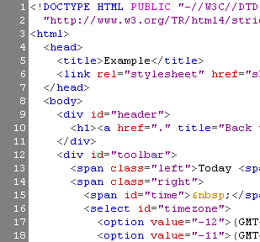


HTML 基础教程
HTML, Text, Images, Tables

Slide 2



网页是如何工作的?
WWW 使用服务器客户机模式
HTTP 是基于文本的请求－响应协议
HTTP
Page request
HTTP
Server response
WEB服务器软件(IIS, Apache, etc.)
客户端浏览器

Slide 3
什么是网页?
网页是使用html语言编写的文本文件
HTML – Hyper Text Markup Language
（超文本标记语言）
文档的结构(semantic markup)
文档的格式 (presentation markup)
标记提供了页面内容的框架

Slide 4
创建 HTML 页面
一个 HTML 文件的后缀名是 .htm 或者.html
HTML 文件可以用文本编辑器来创建和编辑:
NotePad, NotePad ++, PSPad
或者使用HTML专门的编辑软件:
Microsoft FrontPage
Macromedia Dreamweaver
Netscape Composer
Microsoft Word
Visual Studio

Slide 5



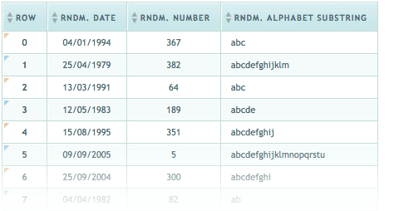

HTML 基础
Text, Images, Tables, Forms

Slide 6
HTML的结构
HTML 由元素和标签组成 “elements” and “tags”
开始标签是<html> ，结束标签是</html>
元素和标签是可以嵌套的
标签具有一些属性:
HTML 两个主要的框架标签是: <head> and <body>
<html> <head></head> <body></body> </html>
<img src="logo.jpg" alt="logo" />

Slide 7
HTML 代码格式要求
HTML的源代码要格式化以增强程序的可阅读性和方便调试
每个标签块要在新的一行开始
每个嵌套的元素要进行缩进
浏览器会忽略到多余的空格，所有格式化不会影响到页面的显示.
在特别需要注意性能的场合，格式化可以不进行

Slide 8
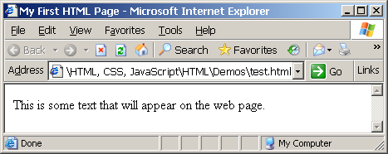
第一个 HTML 页面
test.html
<!DOCTYPE HTML>
<html>
<head>
<title>My First HTML Page</title>
</head>
<body>
<p>This is some text...</p>
</body>
</html>

Slide 9
第一个HTML 页面: 标签
<!DOCTYPE HTML>
<html>
<head>
<title>My First HTML Page</title>
</head>
<body>
<p>This is some text...</p>
</body>
</html>
Opening tag
Closing tag
一个 HTML 元素由开始标签、结束标签和内容组成。

Slide 10
第一个HTML页面: Header
HTML header
<!DOCTYPE HTML>
<html>
<head>
<title>My First HTML Page</title>
</head>
<body>
<p>This is some text...</p>
</body>
</html>

Slide 11
第一个HTML 页面: Body
<!DOCTYPE HTML>
<html>
<head>
<title>My First HTML Page</title>
</head>
<body>
<p>This is some text...</p>
</body>
</html>
HTML body

Slide 12
简单标签
超链接
图片
文字格式
<a href="http://www.telerik.com/"
title="Telerik">Link to Telerik Web site</a>
<img src="logo.gif" alt="logo" />
This text is <em>emphasized.</em>
<br />new line<br />
This one is <strong>more emphasized.</strong>

Slide 13
简单标签
some-tags.html
<!DOCTYPE HTML>
<html>
<head>
<title>Simple Tags Demo</title>
</head>
<body>
<a href="http://www.telerik.com/" title=
"Telerik site">This is a link.</a>
<br />
<img src="logo.gif" alt="logo" />
<br />
<strong>Bold</strong> and <em>italic</em> text.
</body>
</html>

Slide 14
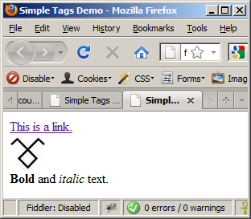
简单标签
some-tags.html
<!DOCTYPE HTML>
<html>
<head>
<title>Simple Tags Demo</title>
</head>
<body>
<a href="http://www.telerik.com/" title=
"Telerik site">This is a link.</a>
<br />
<img src="logo.gif" alt="logo" />
<br />
<strong>Bold</strong> and <em>italic</em> text.
</body>
</html>

Slide 15
标签属性
标签可以拥有属性
属性表达了标签的特性和行为
Example:
一小部分属性是每个标签都具有的:
id, style, class, title
文档中id是唯一的
Title 属性的内容 当鼠标移到元素上显示
一些元素必须要设置属性值
属性 alt 值为 "logo"
<img src="logo.gif" alt="logo" />

Slide 16
标题和段落
Heading 标签 (h1 – h6)
段落标签
章节标签: div and span
<h1>Heading 1</h1>
<h2>Sub heading 2</h2>
<h3>Sub heading 3</h3>
<p>This is my first paragraph</p>
<p>This is my second paragraph</p>
<div style="background: skyblue;">
This is a div</div>

Slide 17
标题和段落
headings.html
<!DOCTYPE HTML>
<html>
<head><title>Headings and paragraphs</title></head>
<body>
<h1>Heading 1</h1>
<h2>Sub heading 2</h2>
<h3>Sub heading 3</h3>
<p>This is my first paragraph</p>
<p>This is my second paragraph</p>
<div style="background:skyblue">
This is a div</div>
</body>
</html>

Slide 18
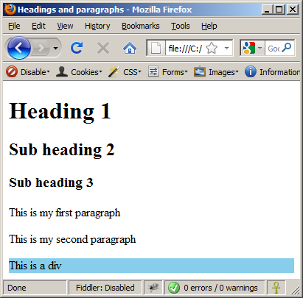
标题和段落
headings.html
<!DOCTYPE HTML>
<html>
<head><title>Headings and paragraphs</title></head>
<body>
<h1>Heading 1</h1>
<h2>Sub heading 2</h2>
<h3>Sub heading 3</h3>
<p>This is my first paragraph</p>
<p>This is my second paragraph</p>
<div style="background:skyblue">
This is a div</div>
</body>
</html>

Slide 19
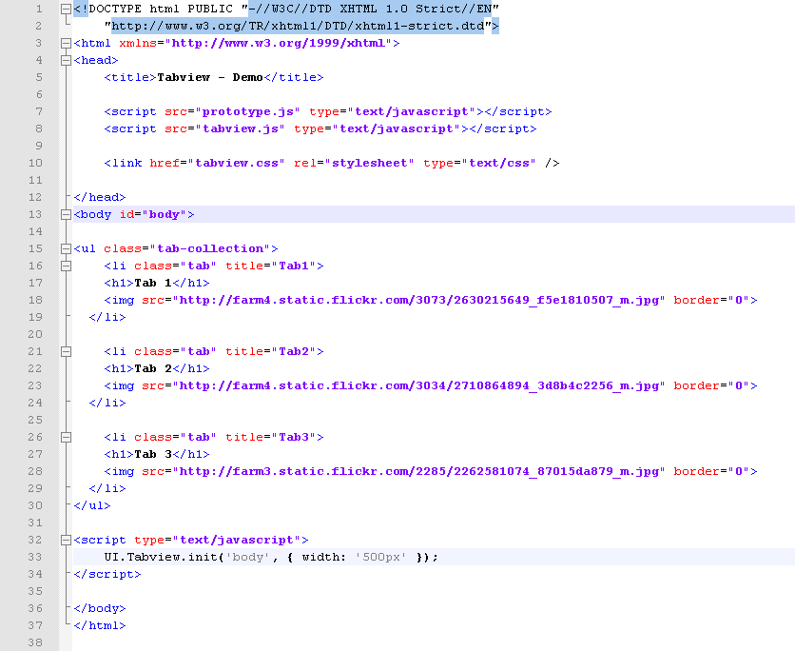
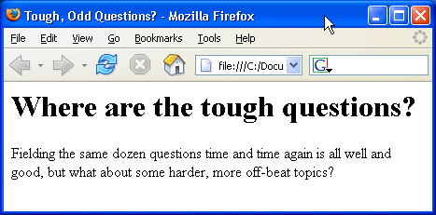
HTML基础
HTML 文档结构

Slide 20
前言
以正确的视角和态度来看待HTML是非常重要的
HTML 只是提供了框架结构，并不提供外观样式
浏览器会兼容无效的HTML代码并解析错误

Slide 21
<!DOCTYPE> 声明
HTML 文档必须以一个文档类型描述开始 (DTD)
它给浏览器指明了文档的类型
可能的类型选择: HTML 4.01, XHTML 1.0 (Transitional or Strict), XHTML 1.1, HTML 5
Example:
登陆 http://w3.org/QA/2002/04/valid-dtd-list.获取可能的类型列表
<!DOCTYPE html PUBLIC "-//W3C//DTD XHTML 1.0 Transitional//EN" "http://www.w3.org/TR/xhtml1/DTD/xhtml1-transitional.dtd">

Slide 22

HTML vs. XHTML
XHTML 比HTML要求更严格
标签和属性的名称必须小写
所有的标签都必须是闭合的 (<br/>, <img/>)
而 HTML 允许隐式闭合的标签 <br> 和 <img> (<p>par1 <p>par2)
XHTML 中只允许出现一个根 <html> 元素 (HTML 允许多个)

Slide 23
XHTML vs. HTML (2)
很多元素的属性在XHTML中都被弃用了，大部分移到了CSS中
属性的简写是不被允许的, e.g.
Note: Web 浏览器 加载 XHTML 比 HTML 快
<input type="checkbox" checked>
<input type="checkbox" checked="checked" />

Slide 24
<head> 标签
包含的信息在页面上是隐藏的
在<!doctype>之后声明
开始于<head> 结束于</head>
包含一个必须存在的<title> 标签
可以嵌套其他一些标签, e.g.
<meta>
<script>
<style>
<!–- comments -->

Slide 25
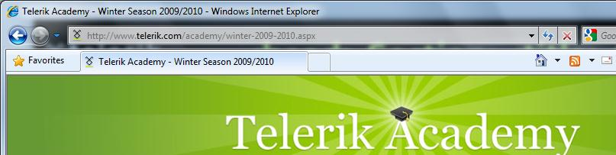
<head> 标签: <title> 标签
Title 需要被放置在<head> 和 </head> 标签之间
用来指定标题栏的内容
搜索引擎和网页浏览者比较关注标题的内容
<title>Telerik Academy – Winter Season 2009/2010 </title>

Slide 26
<head>标签: <meta>
Meta 标签是用来描述页面包含内容的额外信息
<meta name="description" content="HTML tutorial" />
<meta name="keywords" content="html, web design, styles" />
<meta name="author" content="Chris Brewer" />
<meta http-equiv="refresh" content="5; url=http://www.telerik.com" />

Slide 27
<head>标签: <script>
<script> 元素用来网一个 HTML 文档中嵌入脚本
脚本是在客户端浏览器里执行的
脚本可以存在于 <head> 和<body> 标签中
支持的客户端脚本语言:
JavaScript (不是Java!)
VBScript
JScript

Slide 28
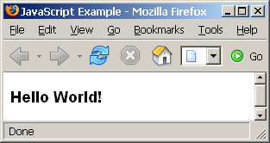
<script> 标签
scripts-example.html
<!DOCTYPE HTML>
<html>
<head>
<title>JavaScript Example</title>
<script type="text/javascript">
function sayHello() {
document.write("<p>Hello World!<\/p>");
}
</script>
</head>
<body>
<script type=
"text/javascript">
sayHello();
</script>
</body>
</html>

Slide 29
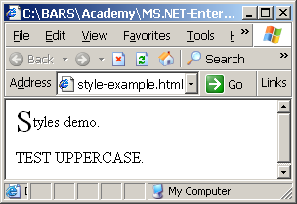
<head> 标签: <style>
<style> 元素用来往HTML页面中嵌入格式信息 (CSS styles)
style-example.html
<html>
<head>
<style type="text/css">
p { font-size: 12pt; line-height: 12pt; }
p:first-letter { font-size: 200%; }
span { text-transform: uppercase; }
</style>
</head>
<body>
<p>Styles demo.<br />
<span>Test uppercase</span>.
</p>
</body>
</html>

Slide 30
注释: <!-- --> 标签
注释可以在<html></html> 之间任意位置出现
注释以<!—开始以 -->结束
<!–- Telerik Logo (a JPG file) -->
<img src="logo.jpg" alt=“Telerik Logo">
<!–- Hyperlink to the web site -->
<a href="http://telerik.com/">Telerik</a>
<!–- Show the news table -->
<table class="newstable">
...

Slide 31
<body> 标签: 概述
<body> 标签中是页面中显示部分
在<head> </head> 之后出现
以 <body> 开始以</body>结束
<html>
<head><title>Test page</title></head>
<body>
<!-- This is the Web page body -->
</body>
</html>

Slide 32
文本格式标签
文本格式标签用来修饰开始和结束标记中文本的样式
Ex. <b>Hello</b> 使得 “Hello” 变为粗体
<b></b> | bold
<i></i> | italicized
<u></u> | underlined
<sup></sup> | Sample^{superscript}
<sub></sub> | Sample_{subscript}
<strong></strong> | strong
<em></em> | emphasized
<pre></pre> | Preformatted text
<blockquote></blockquote> | Quoted text block
<del></del> | Deleted text – strike through

Slide 33
文本格式标签
text-formatting.html
<!DOCTYPE html PUBLIC "-//W3C//DTD XHTML 1.0 Transitional//EN"
"http://www.w3.org/TR/xhtml1/DTD/xhtml1-transitional.dtd">
<html>
<head>
<title>Page Title</title>
</head>
<body>
<h1>Notice</h1>
<p>This is a <em>sample</em> Web page.</p>
<p><pre>Next paragraph:
preformatted.</pre></p>
<h2>More Info</h2>
<p>Specifically, we’re using XHMTL 1.0 transitional.<br />
Next line.</p>
</body>
</html>

Slide 34
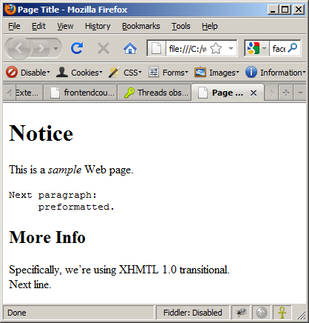
文本格式标签
text-formatting.html
<!DOCTYPE html PUBLIC "-//W3C//DTD XHTML 1.0 Transitional//EN"
"http://www.w3.org/TR/xhtml1/DTD/xhtml1-transitional.dtd">
<html>
<head>
<title>Page Title</title>
</head>
<body>
<h1>Notice</h1>
<p>This is a <em>sample</em> Web page.</p>
<p><pre>Next paragraph:
preformatted.</pre></p>
<h2>More Info</h2>
<p>Specifically, we’re using XHMTL 1.0 transitional.<br />
Next line.</p>
</body>
</html>

Slide 35
超链接: <a> 标签
链接到同一服务器上同一目录的form.html :
链接到同一服务器上上一级目录的parent.html :
链接到同一服务器上子目录stuff中的cat.html :
<a href="form.html">Fill Our Form</a>
<a href="../parent.html">Parent</a>
<a href="stuff/cat.html">Catalog</a>

Slide 36
超链接: <a> 标签
链接到外部网站:
总是使用全URL, 包含 “http://”, 而不只是"www.somesite.com"
使用target=“_blank” 属性指的是在新的窗口打开链接
链接到e-mail 地址:
<a href="http://www.devbg.org" target="_blank">BASD</a>
<a href="mailto:bugs@example.com?subject=Bug+Report">
Please report bugs here (by e-mail only)</a>

Slide 37
超链接: <a> 标签
链接到网页apply-now.html
同一服务器下同一目录
使用图片作为链接:
链接到文档index.html
同一服务器上, 在父目录的子目录english 中:
<a href="apply-now.html"><img
src="apply-now-button.jpg" /></a>
<a href="../english/index.html">Switch to English version</a>

Slide 38
超链接
链接到同一文档中的其它章节:
链接到其它文档中的指定位置:
<a href="#section1">Go to Introduction</a>
...
<h2 id="section1">Introduction</h2>
<a href="chapter3.html#section3.1.1">Go to Section 3.1.1</a>
<!–- In chapter3.html -->
...
<div id="section3.1.1">
<h3>3.1.1. Technical Background</h3>
</div>

Slide 39
超链接
hyperlinks.html
<a href="form.html">Fill Our Form</a> <br />
<a href="../parent.html">Parent</a> <br />
<a href="stuff/cat.html">Catalog</a> <br />
<a href="http://www.devbg.org" target="_blank">BASD</a> <br />
<a href="mailto:bugs@example.com?subject=Bug Report">Please report bugs here (by e-mail only)</a>
<br />
<a href="apply-now.html"><img src="apply-now-button.jpg” /></a> <br />
<a href="../english/index.html">Switch to English version</a> <br />

Slide 40
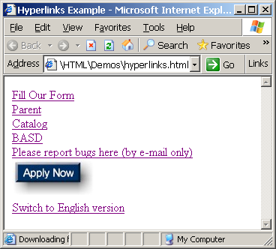
超链接
hyperlinks.html
<a href="form.html">Fill Our Form</a> <br />
<a href="../parent.html">Parent</a> <br />
<a href="stuff/cat.html">Catalog</a> <br />
<a href="http://www.devbg.org" target="_blank">BASD</a> <br />
<a href="mailto:bugs@example.com?subject=Bug Report">Please report bugs here (by e-mail only)</a>
<br />
<a href="apply-now.html"><img src="apply-now-button.jpg” /></a> <br />
<a href="../english/index.html">Switch to English version</a> <br />

Slide 41
链接到同一文档
links-to-same-document.html
<h1>Table of Contents</h1>
<p><a href="#section1">Introduction</a><br />
<a href="#section2">Some background</A><br />
<a href="#section2.1">Project History</a><br />
...the rest of the table of contents...
<!-- The document text follows here -->
<h2 id="section1">Introduction</h2>
... Section 1 follows here ...
<h2 id="section2">Some background</h2>
... Section 2 follows here ...
<h3 id="section2.1">Project History</h3>
... Section 2.1 follows here ...

Slide 42
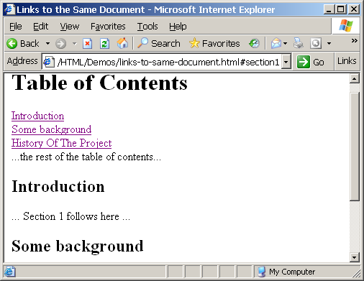
链接到同一文档
links-to-same-document.html
<h1>Table of Contents</h1>
<p><a href="#section1">Introduction</a><br />
<a href="#section2">Some background</A><br />
<a href="#section2.1">Project History</a><br />
...the rest of the table of contents...
<!-- The document text follows here -->
<h2 id="section1">Introduction</h2>
... Section 1 follows here ...
<h2 id="section2">Some background</h2>
... Section 2 follows here ...
<h3 id="section2.1">Project History</h3>
... Section 2.1 follows here ...

Slide 43
图片: <img> 标签
用<img> 标签在网页中插入图片:
图片的属性:
Example:
<img src="/img/basd-logo.png">
src | Location of image file (relative or absolute)
alt | Substitute text for display (e.g. in text mode)
height | Number of pixels of the height
width | Number of pixels of the width
border | Size of border, 0 for no border
<img src="./php.png" alt="PHP Logo" />

Slide 44
其它标签
<hr />: 水平线:
<center></center>: 不再使用!
<font></font>:不再使用!
<hr size="5" width="70%" />
<center>Hello World!</center>
<font size="3" color="blue">Font3</font>
<font size="+4" color="blue">Font+4</font>

Slide 45
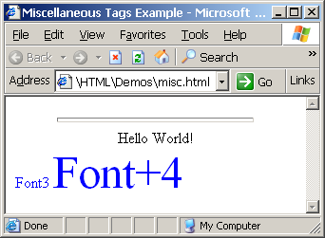
其它标签
misc.html
<html>
<head>
<title>Miscellaneous Tags Example</title>
</head>
<body>
<hr size="5" width="70%" />
<center>Hello World!</center>
<font size="3" color="blue">Font3</font>
<font size="+4" color="blue">Font+4</font>
</body>
</html>

Slide 46
有序列表: <ol> 标签
使用<ol></ol>创建有序列表:
属性值用来指明列表类型1, A, a, I, or i
<ol type="1">
<li>Apple</li>
<li>Orange</li>
<li>Grapefruit</li>
</ol>
Apple
Orange
Grapefruit
Apple
Orange
Grapefruit
Apple
Orange
Grapefruit
Apple
Orange
Grapefruit
Apple
Orange
Grapefruit

Slide 47
无序列表: <ul> 标签
使用<ul></ul>来创建无序列表:
Type属性的值可设置为:
disc, circle or square
<ul type="disk">
<li>Apple</li>
<li>Orange</li>
<li>Grapefruit</li>
</ul>
Apple
Orange
Pear
Apple
Orange
Pear
Apple
Orange
Pear

Slide 48
定义列表: <dl> tag
创建定义列表使用标签<dl>
由文本和其对应的定义构成; 文本在 <dt> 标签中,相关定义放置在 <dd> 标签中
Renders without bullets
Definition is indented
<dl>
<dt>HTML</dt>
<dd>A markup language …</dd>
<dt>CSS</dt>
<dd>Language used to …</dd>
</dl>

Slide 49
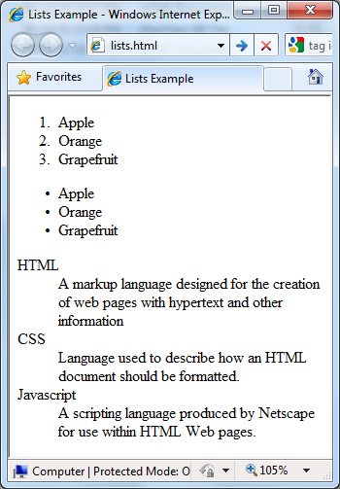
Lists – Example
lists.html
<ol type="1">
<li>Apple</li>
<li>Orange</li>
<li>Grapefruit</li>
</ol>
<ul type="disc">
<li>Apple</li>
<li>Orange</li>
<li>Grapefruit</li>
</ul>
<dl>
<dt>HTML</dt>
<dd>A markup lang…</dd>
</dl>

Slide 50
HTML 特殊字符
Symbol Name
HTML Entity
Symbol
Copyright Sign
&copy;
©
Registered Trademark Sign
&reg;
®
Trademark Sign
&trade;
™
Less Than
&lt;
<
Greater Than
&gt;
>
Ampersand
&amp;
&
Non-breaking Space
&nbsp;
Em Dash
&mdash;
—
Quotation Mark
&quot;
"
Euro
&#8364;
€
British Pound
&pound;
£
Japanese Yen
&yen;
¥

Slide 51
特殊字符– Example
special-chars.html
<p>[&gt;&gt;&nbsp;&nbsp;Welcome
&nbsp;&nbsp;&lt;&lt;]</p>
<p>&#9658;I have following cards:
A&#9827;, K&#9830; and 9&#9829;.</p>
<p>&#9658;I prefer hard rock &#9835;
music &#9835;</p>
<p>&copy; 2006 by Svetlin Nakov &amp; his team</p>
<p>Telerik Academy™</p>

Slide 52
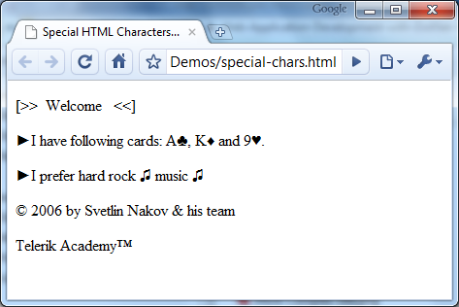
特殊字符– Example (2)
special-chars.html
<p>[&gt;&gt;&nbsp;&nbsp;Welcome
&nbsp;&nbsp;&lt;&lt;]</p>
<p>&#9658;I have following cards:
A&#9827;, K&#9830; and 9&#9829;.</p>
<p>&#9658;I prefer hard rock &#9835;
music &#9835;</p>
<p>&copy; 2006 by Svetlin Nakov &amp; his team</p>
<p>Telerik Academy™</p>

Slide 53
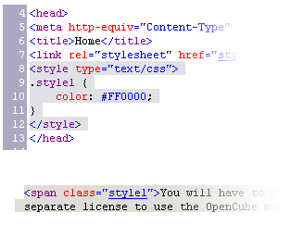

使用块标签 <DIV> 、<SPAN>

Slide 54
块标签和内联元素
块元素会在显示时分别在开始和之后加上一行换行
<div> 是块元素
其它的块元素有<table>, <hr>, 头部, 列表, <p>.
内联元素
<span> 是内联元素
大部分 HTML 元素是内联的, e.g. <a>

Slide 55
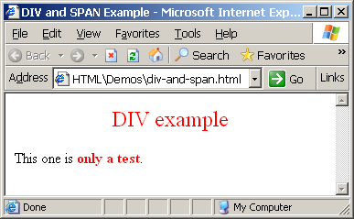
<div> 标签
<div> 在页面中创建了一个逻辑划分
块样式元素
使用 CSS
示例:
div-and-span.html
<div style="font-size:24px; color:red">DIV example</div>
<p>This one is <span style="color:red; font-weight:bold">only a test</span>.</p>

Slide 56
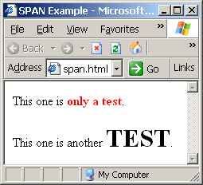
<span> 标签
内联样式元素
对于修饰文本的一个特定部分非常有用
不会在文档中创建一个分割的
区域或段落
对于 CSS非常有用
span.html
<p>This one is <span style="color:red; font-weight:bold">only a test</span>.</p>
<p>This one is another <span style="font-size:32px; font-weight:bold">TEST</span>.</p>

Slide 57
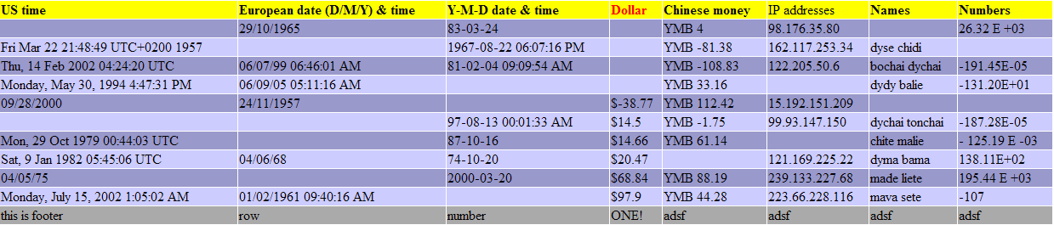
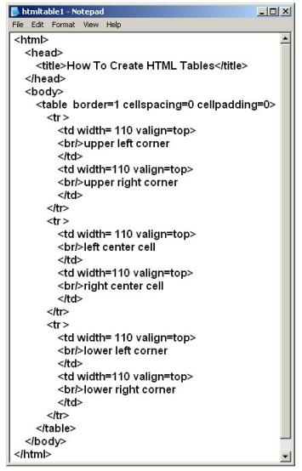
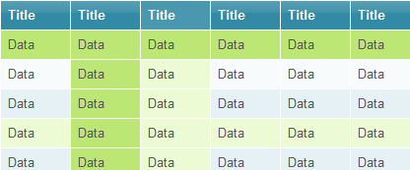
HTML 表格

Slide 58
HTML 表格
表格用来表示
一个表格由一行或多行构成
每一行由一列或多列构成
表格由多个核心标签构成:
<table></table>: 表格的开始和结束 <tr></tr>:创建表格的一行 <td></td>: 创建单元格
表格比应该被用来做布局而使用 CSS 的floats 属性和位置样式来替代。

Slide 59
HTML 表格
Start and end of a table
Start and end of a row
Start and end of a cell in a row
<table> ... </table>
<tr> ... </tr>
<td> ... </td>

Slide 60
HTML 表格
<table cellspacing="0" cellpadding="5">
<tr>
<td><img src="ppt.gif"></td>
<td><a href="lecture1.ppt">Lecture 1</a></td>
</tr>
<tr>
<td><img src="ppt.gif"></td>
<td><a href="lecture2.ppt">Lecture 2</a></td>
</tr>
<tr>
<td><img src="zip.gif"></td>
<td><a href="lecture2-demos.zip">
Lecture 2 - Demos</a></td>
</tr>
</table>

Slide 61
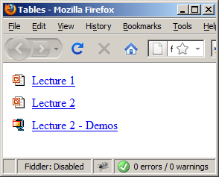
HTML 表格
<table cellspacing="0" cellpadding="5">
<tr>
<td><img src="ppt.gif"></td>
<td><a href="lecture1.ppt">Lecture 1</a></td>
</tr>
<tr>
<td><img src="ppt.gif"></td>
<td><a href="lecture2.ppt">Lecture 2</a></td>
</tr>
<tr>
<td><img src="zip.gif"></td>
<td><a href="lecture2-demos.zip">
Lecture 2 - Demos</a></td>
</tr>
</table>

Slide 62
完整的HTML 表格
表格中的行可以划分为三个语义段: header, body and footer
<thead> denotes table header and contains <th> elements, instead of <td> elements
<tbody> denotes collection of table rows that contain the very data
<tfoot> denotes table footer but comes BEFORE the <tbody> tag
<colgroup> and <col> define columns (most often used to set column widths)

Slide 63
完整的HTML 表格
<table>
<colgroup>
<col style="width:100px" /><col />
</colgroup>
<thead>
<tr><th>Column 1</th><th>Column 2</th></tr>
</thead>
<tfoot>
<tr><td>Footer 1</td><td>Footer 2</td></tr>
</tfoot>
<tbody>
<tr><td>Cell 1.1</td><td>Cell 1.2</td></tr>
<tr><td>Cell 2.1</td><td>Cell 2.2</td></tr>
</tbody>
</table>
columns
header
th
footer
Last comes the body (data)

Slide 64
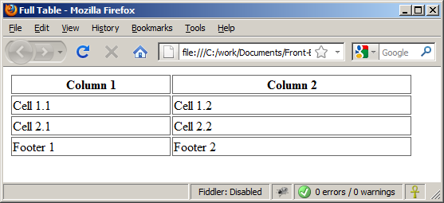
完整的HTML 表格
By default, header text is bold and centered.
table-full.html
<table>
<colgroup>
<col style="width:200px" /><col />
</colgroup>
<thead>
<tr><th>Column 1</th><th>Column 2</th></tr>
</thead>
<tfoot>
<tr><td>Footer 1</td><td>Footer 2</td></tr>
</tfoot>
<tbody>
<tr><td>Cell 1.1</td><td>Cell 1.2</td></tr>
<tr><td>Cell 2.1</td><td>Cell 2.2</td></tr>
</tbody>
</table>
Although the footer is before the data in the code, it is displayed last

Slide 65
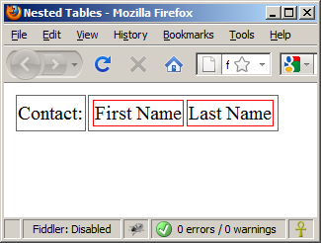
嵌套的表格
Table data “cells” (<td>) can contain nested tables (tables within tables):
nested-tables.html
<table>
<tr>
<td>Contact:</td>
<td>
<table>
<tr>
<td>First Name</td>
<td>Last Name</td>
</tr>
</table>
</td>
</tr>
</table>

Slide 66
单元格的Spacing and Padding
表格有两个重要的属性:
cellspacing
Defines the empty space between cells
cellpadding
Defines the empty space around the cell content
cell
cell
cell
cell
cell
cell
cell
cell

Slide 67
Cell Spacing and Padding – Example
table-cells.html
<html>
<head><title>Table Cells</title></head>
<body>
<table cellspacing="15" cellpadding="0">
<tr><td>First</td>
<td>Second</td></tr>
</table>
<br/>
<table cellspacing="0" cellpadding="10">
<tr><td>First</td><td>Second</td></tr>
</table>
</body>
</html>

Slide 68
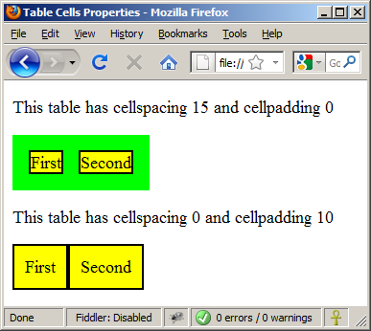
Cell Spacing and Padding – Example (2)
table-cells.html
<html>
<head><title>Table Cells</title></head>
<body>
<table cellspacing="15" cellpadding="0">
<tr><td>First</td>
<td>Second</td></tr>
</table>
<br/>
<table cellspacing="0" cellpadding="10">
<tr><td>First</td><td>Second</td></tr>
</table>
</body>
</html>

Slide 69
Column and Row Span
单元格有两个重要的属性:
colspan
Defines how many columns the cell occupies
rowspan
Defines how many rows the cell occupies
colspan="1"
colspan="1"
rowspan="2"
rowspan="1"
cell[1,1]
cell[1,2]
cell[1,1]
cell[1,2]
cell[2,1]
cell[2,1]
colspan="2"
rowspan="1"

Slide 70
Column and Row Span – Example
table-colspan-rowspan.html
<table cellspacing="0">
<tr class="1"><td>Cell[1,1]</td>
<td colspan="2">Cell[2,1]</td></tr>
<tr class=“2"><td>Cell[1,2]</td>
<td rowspan="2">Cell[2,2]</td>
<td>Cell[3,2]</td></tr>
<tr class=“3"><td>Cell[1,3]</td>
<td>Cell[2,3]</td></tr>
</table>

Slide 71
Column and Row Span – Example (2)
table-colspan-rowspan.html
<table cellspacing="0">
<tr class="1"><td>Cell[1,1]</td>
<td colspan="2">Cell[2,1]</td></tr>
<tr class=“2"><td>Cell[1,2]</td>
<td rowspan="2">Cell[2,2]</td>
<td>Cell[3,2]</td></tr>
<tr class=“3"><td>Cell[1,3]</td>
<td>Cell[2,3]</td></tr>
</table>
Cell[1,1]
Cell[2,1]
Cell[1,2]
Cell[2,2]
Cell[3,2]
Cell[1,3]
Cell[2,3]

Slide 72
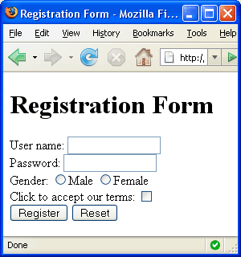


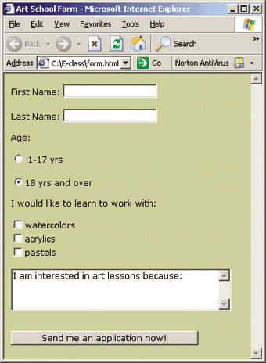
HTML 表单
Entering User Data from a Web Page

Slide 73
HTML 表单
表单是从网站访问者获得信息的主要方法
示例:
<form></form>
<form name="myForm" method="post" action="path/to/some-script.php">
...
</form>

Slide 74
表单元素
单行文本输入域:
多行文本输入域:
隐藏域:
经常被JavaScript 代码调用
<input type="text" name="FirstName" value="This is a text field" />
<textarea name="Comments">This is a multi-line text field</textarea>
<input type="hidden" name="Account" value="This is a hidden text field" />

Slide 75
Fieldsets
Fieldsets 用来包含一组表单控件:
<legend> 是表单控件域的标题
<form method="post" action="form.aspx">
<fieldset>
<legend>Client Details</legend>
<input type="text" id="Name" />
<input type="text" id="Phone" />
</fieldset>
<fieldset>
<legend>Order Details</legend>
<input type="text" id="Quantity" />
<textarea cols="40" rows="10" id="Remarks"></textarea>
</fieldset>
</form>

Slide 76
Form Input Controls
复选控件:
单选控件:
单选控件通常被设置成一个组，每组中只能有一个被选中:
<input type="checkbox" name="fruit" value="apple" />
<input type="radio" name="title" value="Mr." />
<input type="radio" name="city" value="Lom" />
<input type="radio" name="city" value="Ruse" />

Slide 77
Other Form Controls
下拉菜单:
提交按钮:
<select name="gender">
<option value="Value 1"
selected="selected">Male</option>
<option value="Value 2">Female</option>
<option value="Value 3">Other</option>
</select>
<input type="submit" name="submitBtn" value="Apply Now" />

Slide 78
Other Form Controls (2)
重置按钮 – 使表单控件恢复到初始状态
图片按钮
普通按钮
<input type="reset" name="resetBtn" value="Reset the form" />
<input type="image" src="submit.gif" name="submitBtn" alt="Submit" />
<input type="button" value="click me" />

Slide 79
Other Form Controls (3)
密码框
多选控件
<input type="password" name="pass" />
<select name="products" multiple="multiple">
<option value="Value 1"
selected="selected">keyboard</option>
<option value="Value 2">mouse</option>
<option value="Value 3">speakers</option>
</select>

Slide 80
Other Form Controls (4)
文件输入控件– 用来上传文件的
需要表单元素具有一个特殊属性
<input type="file" name="photo" />
<form enctype="multipart/form-data">
...
<input type="file" name="photo" />
...
</form>

Slide 81
Labels
表单标签用来描述某个控件的含义
Clicking on a label focuses its associated field (checkboxes are toggled, radio buttons are checked)
Labels are both a usability and accessibility feature and are required in order to pass accessibility validation.
<label for="fn">First Name</label>
<input type="text" id="fn" />

Slide 82
HTML Forms – Example
form.html
<form method="post" action="apply-now.php">
<input name="subject" type="hidden" value="Class" />
<fieldset><legend>Academic information</legend>
<label for="degree">Degree</label>
<select name="degree" id="degree">
<option value="BA">Bachelor of Art</option>
<option value="BS">Bachelor of Science</option>
<option value="MBA" selected="selected">Master of
Business Administration</option>
</select>
<br />
<label for="studentid">Student ID</label>
<input type="password" name="studentid" />
</fieldset>
<fieldset><legend>Personal Details</legend>
<label for="fname">First Name</label>
<input type="text" name="fname" id="fname" />
<br />
<label for="lname">Last Name</label>
<input type="text" name="lname" id="lname" />

Slide 83
HTML Forms – Example (2)
form.html
<br />
Gender:
<input name="gender" type="radio" id="gm" value="m" />
<label for="gm">Male</label>
<input name="gender" type="radio" id="gf" value="f" />
<label for="gf">Female</label>
<br />
<label for="email">Email</label>
<input type="text" name="email" id="email" />
</fieldset>
<p>
<textarea name="terms" cols="30" rows="4"
readonly="readonly">TERMS AND CONDITIONS...</textarea>
</p>
<p>
<input type="submit" name="submit" value="Send Form" />
<input type="reset" value="Clear Form" />
</p>
</form>

Slide 84
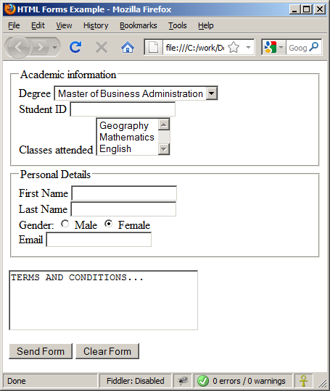
HTML Forms – Example (3)
form.html

Slide 85
TabIndex
The tabindex HTML attribute controls the order in which form fields and hyperlinks are focused when repeatedly pressing the TAB key
tabindex="0" (zero) - "natural" order
If X > Y, then elements with tabindex="X" are iterated before elements with tabindex="Y"
Elements with negative tabindex are skipped, however, this is not defined in the standard
<input type="text" tabindex="10" />

Slide 86
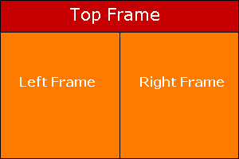
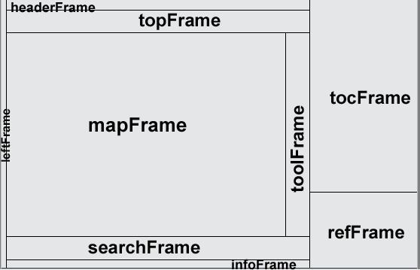
HTML 框架
<frameset>, <frame> and <iframe>

Slide 87
HTML Frames
Frames provide a way to show multiple HTML documents in a single Web page
The page can be split into separate views (frames) horizontally and vertically
Frames were popular in the early ages of HTML development, but now their usage is rejected
Frames are not supported by all user agents (browsers, search engines, etc.)
A <noframes> element is used to provide content for non-compatible agents.

Slide 88
HTML Frames – Demo
frames.html
<html>
<head><title>Frames Example</title></head>
<frameset cols="180px,*,150px">
<frame src="left.html" />
<frame src="middle.html" />
<frame src="right.html" />
</frameset>
</html>
Note the target attribute applied to the <a> elements in the left frame.

Slide 89
Inline Frames: <iframe>
Inline frames provide a way to show one website inside another website:
iframe-demo.html
<iframe name="iframeGoogle" width="600" height="400" src="http://www.google.com" frameborder="yes" scrolling="yes"></iframe>

